Slide 1
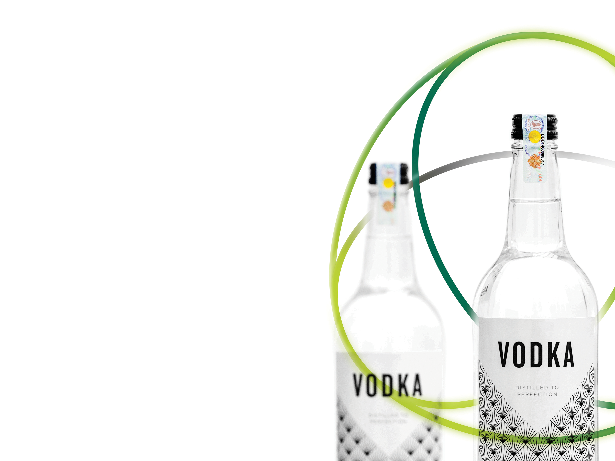
CUSTOMS & BUSINESS
22nd May 2015

Slide 2
Agenda
About us
Customs & Business… As a customer
What have we learnt?
Customs & Business… As an advisor and partner
What have we learnt?
Customs & Business… As a solutions provider
What have we learnt?
Summary

Slide 3
About us
At the forefront of government authentication solutions, De La Rue is a trusted partner of governments around the globe.
We produce over 150 national currencies and passports for over 50 countries
Specialist technology services for cash, identity and authentication solutions
4000 employees, 27 international locations
Over 30 anti-illicit trade solutions implemented for alcohol and tobacco
First ATM (with Barclays) and first FMCG global authentication & traceability program (with Microsoft)
Our approach
Complexity simplified
Protect needs of Government revenue, health and industry
Manufacturer designed solution
In relation to Customs we are quite unique…
We are a customer, an adviser, a partner and a solutions provider

Slide 4
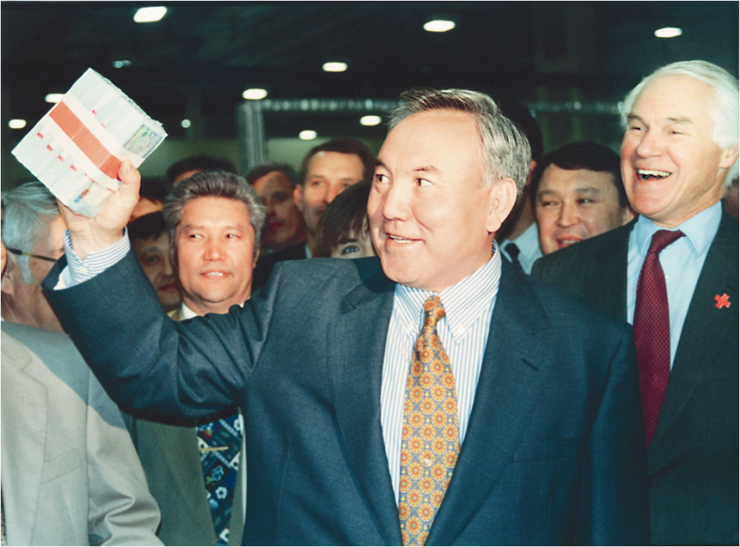
Customs & Business… As a customer
We are a customer, an adviser, a partner and a solutions provider
Customer
Customers in over 150 Countries
Business presence in over 20 Countries
Specialist manufacture in 8 Countries
Our products range from complete physical solutions,
components to digital solutions
We operate globally in the following areas
Customs Partnership and Cooperation
Trusted Trader
Authorised Economic Operator
Export Processing Zones
Free Zone Company
President of Kazakhstan and De La Rue CEO at the launch of national currency
Local Customs
Utilise Inward and Outward Processing Relief
Process under Preference
Goods in Transit
Authorised Approved Exporter Status

Slide 5
Customs & Business… As a customer
What have we learnt?
Customs Expectation
Honesty
Correct , legitimate business procedures
Good quality data
Reliability
Compliance
Making risk analysis easier
Assisting security
Affecting change via full engagement with current issues
Business Expectation
Transparency.
Predictability and speed of clearance
Raising of standards and the control of corruption.
Efficiencies and speed at the frontier in Customs processes.
Joined –up frontier interdiction
Reciprocal arrangement with other jurisdictions
Availability of special procedures with economic impact
Desire to be involved in the decision making processes

Slide 6
Customs & Business… As an advisor and partner
We are a customer, an adviser, a partner and a solutions provider
Adviser
We sit on the Private Sector Consultative Group (PSCG) in place since 2006
Input to the development of Standards to “Secure and Facilitate Global Trade” – SAFE Framework
Orientation package - Capacity building
Guidance to policy
Looking forward to a new PSCG where all of our global entities will be represented
Partner
Partner on the WCO IPM Pilot programme
IPM is a training, detection and communication tool between field Customs officers and companies affected by counterfeiting
The pilot is in line with initiatives of other regional and international organizations such as: the European Commission's informal expert group on product traceability, the OECD working group on consumer product safety and UNICRI's programme on counterfeiting;

Slide 7
Customs & Business… As an advisor and partner
What have we learnt?
Adviser
International representation is key
Business agenda must track Customs agenda
We are keen to get more involved e.g. Capacity Building
WTO ATF – How do we do this together?
SAFE is progressing well, what next?
Partner
Common technology between Customs & Business is key
Data must be based on standards to share between Member States and Business
We have the same goals – protect borders and increase genuine trade

Slide 8
Customs & Business… As a solutions provider
We are a customer, an adviser, a partner and a solutions provider
Case study - Solution to fight an illicit trade in alcohol and tobacco products
Illicit trade occurs in 3 main forms; smuggled, counterfeit and tax evasion
Est.30% of the total sale of alcohol is illicit trade in many countries
Government Revenue Protection Solution must help countries to protect tax revenues and customs duties from illicit trade
Solution is not just to physically mark tobacco and alcohol manufactured or imported, but to allow it to be traced through the supply chain and be authenticated
Programmes should protect genuine trade and highlight illicit trade

Slide 9
Customs & Business… As a solutions provider
What have we learnt?
Solution qualification is key
Engage and talk to your suppliers
Specify an open platform solution where data can be shared between Member States
Specify the problem, not the solution
Supplier qualification is key
Size, experience, transparency, independence
Buying Guidelines
Allow enough time for suppliers to bid and deliver
Include face to face meetings & presentation
Provide all necessary data
Set up a tender committee and include stakeholders

Slide 10
Customs & Business… As a solutions provider
Government
Minister of Finance
Minister of Health
Tobacco Control
DG Revenue
Tax Auditor
DG Customs
Police
Enforcement
Procurement
Legal
Commercial
IT
External
Manufacturers
Trade Associations
Distributors
Haulage
Health
Enforcement
Taxation
IMF / World Bank
Regional Groups

Slide 11
Summary
Customer
Customs & Business have the same goals
Facilitate genuine trade
Protect against illicit trade
Advisor & Partner
Allowing Business to engage with Customs is essential to our joint success
We have a lot to share
International companies can offer local views
Solutions provider
Engage and share information early
Specify the problem not the solution; ensuring data can be accessed
Look for an independent partner to work well with Customs & Business

